Slide 1
Object Orientation with Design Patterns
Lecture 1 : Objects & Classes revision

Slide 2
Objects
Object-oriented programming is modelled on how, in the real world, objects are often made up of many kinds of smaller objects.
This capability of combining objects, however, is only one very general aspect of object-oriented programming. Object-oriented programming provides several other concepts and features to make creating and using objects easier and more flexible, and the most important of these features is classes.
When you write a program in an object-oriented language, you don't define actual objects. You define classes of objects, where a class is a template for multiple objects with similar features.
Lecturer: Orla McMahon

Slide 3
Objects
Classes embody all the features of a particular set of objects.
For example, you might have a Tree class that describes the features of all trees (has leaves and roots, grows, creates chlorophyll). The Tree class serves as an abstract model for the concept of a tree-to reach out and grab, or interact with, or cut down a tree you have to have a concrete instance of that tree. Of course, once you have a tree class, you can create lots of different instances of that tree, and each different tree instance can have different features (short, tall, bushy, drops leaves in autumn), while still behaving like and being immediately recognizable as a tree
Lecturer: Orla McMahon

Slide 4
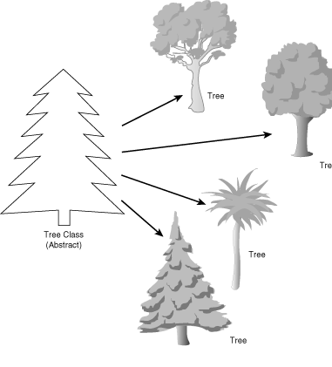
Objects
Lecturer: Orla McMahon

Slide 5
Objects
Definition of a class
  A class is a generic template for a set of objects with similar features.
An instance of a class is another word for an actual object.
If class is the general (generic) representation of an object, an instance is its concrete representation.
So what, precisely, is the difference between an instance and an object? Nothing, really. Object is the more general term, but both instances and objects are the concrete representation of a class. In fact, the terms instance and object are often used interchangeably in OOP lingo. An instance of a tree and a tree object are both the same thing.
Lecturer: Orla McMahon

Slide 6
Objects
Definition of an Instance
  An instance is the specific concrete representation of a class. Instances and objects are the same thing.
Another way of distinguishing classes from objects is as follows:
  A class exists at design time, i.e. when we are writing OO code to solve problems.
  An object exists at runtime when the program that we have just coded is running.
This distinction will become much clearer later on. For now lets look at writing a very simple class in Java.
Lecturer: Orla McMahon

Slide 7
Objects
Lets say for example you wanted to write a program to store information on your CD collection. You may want to store certain information on each CD such as:
  Title
  Artist
  Number of tracks
  Favourite track
This can be easily achieved in Java by writing a class called CompactDisk which will represent the abstract concept of a CD.
We will then be able to create as much CompactDisc objects as we like in order to model our CD collection. All of these objects will be an instance of our CompactDisc class.
Lecturer: Orla McMahon

Slide 8
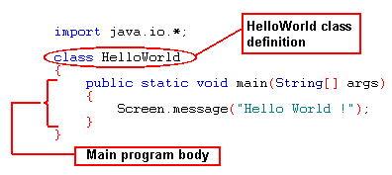
Writing classes in Java
We have actually written a lot of classes in Java already. It is impossible to write even a simple program in Java without having to write a class.
In Java even your program is a class, lets look at an example.
Lecturer: Orla McMahon

Slide 9
Writing classes in Java
In the HelloWorld program on the previous slide we can see the line of code which reads:
  class HelloWorld
Here we are actually creating a new class which will represent our Java program.
As was stated in the first lecture the Java programming language is truly object oriented, there’s no getting away from classes and there’s certainly no getting away from objects.
Lecturer: Orla McMahon

Slide 10
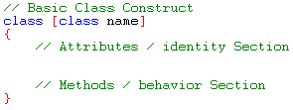
The class construct
It is essential that we understand and can use the class construct in Java. As we have seen in previous examples even our programs are defined by a classes.
There are a number of important aspects of object oriented programming which we must address before we can write any useful classes such as the CompactDisc class.
    Class Attributes
    Class Methods/operations
    Data Hiding & Encapsulation
Lecturer: Orla McMahon

Slide 11
Attributes
When we try to model objects in the real world we usually pick certain aspects about them which uniquely make them what they are.
For example if we were to describe a car we may choose the following aspects:
    Make, Model, Colour, Engine Capacity, Year, Reg
If we were to model a table we might choose the following aspects:
    Width, Length, Height, No. Legs
In the context of object oriented programming all of the above examples would be attributes of a car or table object.
Lecturer: Orla McMahon

Slide 12

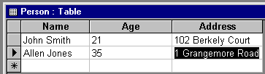
Attributes
So an object is defined by its attributes
You can think of an objects attributes as being like fields in a database table or fields in a structure that is part of a ‘C’ program.
Lecturer: Orla McMahon

Slide 13
Methods/operations
Not only does an object have a definition which is given by its attributes, it can also have a behaviour.
For example a dog object may have the following behaviours:
    Walk, sleep, run, eat, drink, sh*t…. And so on
A car object may have the following behaviours:
    Start engine, stop engine, engage clutch, change gears…. And so on
We can add behaviour to our objects by including methods in their class definition. Methods or operations are just another name for functions which are defined inside the class.
Lecturer: Orla McMahon

Slide 14


What is:
  Encapsulation?
  Data Hiding?
Lecturer: Orla McMahon

Slide 15
Data hiding & Encapsulation
Encapsulation and data hiding bind data and procedures (operations) together and limit the scope and visibility of the procedures and functions that can manipulate the data to a highly localized region of code in the software system(the class).
The data and related procedures become inseparable and a new entity called an object is defined.
Encapsulation is the binding of the underlying data(attributes) with an associated set of procedures and functions(behavior) that can manipulate the data.
(Attributes of object can be manipulated ONLY by methods of the object- we close off our classes and protect attributes from outside interference)
Data hiding is the inaccessibility of the internal structure of the underlying data.(more on this later)
Example:
  https://www.tutorialspoint.com/java/java_encapsulation.htm
Lecturer: Orla McMahon

Slide 16
Data hiding & Encapsulation
Objects are defined in terms of classes. A class description defines the characteristics of all objects declared to be of a given class. The class construct also provides the basic unit of reusability in Java.
It binds the underlying data type with a set of methods (functions/interface) that allow the underlying data type to be manipulated by passing messages to the object (calling its functions).
Data hiding is achieved by using access modifiers to limit the visibility of an objects attributes and methods to the outside world. There are two access modifiers that we should be aware of at this point, private and public.
Lecturer: Orla McMahon

Slide 17

Creating a class
The best way to get comfortable with all of this new knowledge is to write a class of our own. So lets have a go at writing the CompactDisc class.
Let's start with a basic class definition. Open the text editor you've been using to create Java source code and enter the following (remember, upper- and lowercase matters):
Congratulations! You've now created a class. Of course, it doesn't do very much at the moment, but that's a Java class at its very simplest.
Lecturer: Orla McMahon

Slide 18
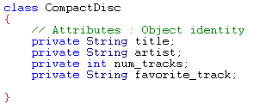
Creating a class
Now lets add some attributes to the class definition
Now that our class has some attributes we can begin to define some of its behaviors. We will need to be able to set values for all of its attributes and we will also need to be able to query it for an attribute value. For example we might want to give a CD object the title “White Ladder” and the artist “David Gray”. We may also want to be able to ask an object, what’s your title? What’s your artist and so on.
Lecturer: Orla McMahon

Slide 19
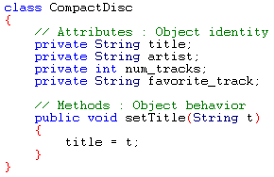
Creating a class
Remember in order to add behavior all we have to do is add some functions to the class definition. So for example we could add the following method to set a CD’s title.
Lecturer: Orla McMahon

Slide 20
Creating a class
The best way to see how all of this works is to write a small test program which will run our CompactDisc class through its paces.
Open the text editor you've been using to create Java source code and enter the following. This file must be saved in the same directory as the CompactDisc.java file.
Lecturer: Orla McMahon

Slide 21
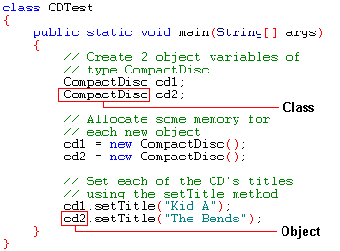
Creating a class
Lecturer: Orla McMahon

Slide 22
Creating a class
If you compile and run this test program it does absolutely nothing, why?
All we have done is created two CompactDisc objects and set their titles.
How do we know whether each CD object cd1, cd2, has received the given titles?
By adding a second method to query the CD object for its title we will be able to assure ourselves that each objects attribute has been set successfully.
Lecturer: Orla McMahon

Slide 23
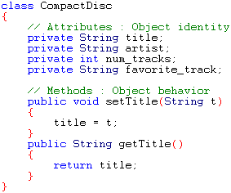
Creating a class
Lecturer: Orla McMahon

Slide 24
Creating a class
The getTitle method returns the current value stored by the title attribute.
Question : will this value be the same for each object ?
Lets find out by modifying our test program. We can answer the question above by outputting the title values for cd1 and cd2 using the getTitle method.
Lecturer: Orla McMahon

Slide 25
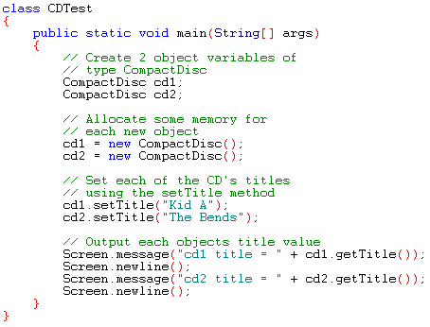
Creating a class
Lecturer: Orla McMahon

Slide 26
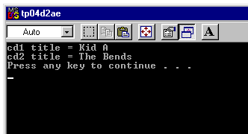
Creating a class
When we compile and run the test program now we get the following output
So the answer to the question is no, each object will be able to store its own set of attribute values. This means that even though we have created the two objects using same class they will both have their own personal copy of data.
Lecturer: Orla McMahon

Slide 27
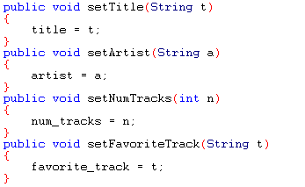
Creating a class
Now that we are happy that our CompactDisc class is working we can add set and get methods for each attribute. All of these methods will be based on the setTitle and getTitle methods.
  Full compliment of Set methods
Lecturer: Orla McMahon

Slide 28
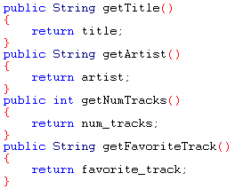
Creating a class
  Full compliment of Get methods
Lecturer: Orla McMahon

Slide 29
Private & Public access modifiers
As we mentioned earlier, Data hiding is one of the most important features of object oriented programming. Data hiding is achieved through the use of the Java keyword private.
If you examine the CompactDisc class you will see that all the attribute declarations are preceded by the keyword private. This tells the java compiler that the attribute variables can only be referenced within the scope of the CompactDisc class.
So the attribute variables can only be accessed directly within the CompactDisc class. If we need to access the attribute variables from outside of the class, i.e. in the test program we must use one of the classes get methods.
Lecturer: Orla McMahon

Slide 30

Silly
  10 x 2 and 11 x 2 get the same answer.
  How?
Lecturer: Orla McMahon

Slide 31

I have brought the greatest civilizations down from lack of me, I am small in size and weight.
I can be destroyed at will with no effort but I am very powerful, people kill for me.
What am I?
Lecturer: Orla McMahon

